Slide 1

YOU’RE
ON MUTE!
A Device to Control M$ Teams
Paul Harvey
Notes:
Following on from my business-focused BBC Micro emulator from last time!
Often find myself doing other things during Teams meetings.
Then struggle to find the right Teams Window / unmute when suddenly needed.
This project develops a – maybe the not most straightforward! – solution to the problem.
Not really just an excuse to learn something about electronics!

Slide 2
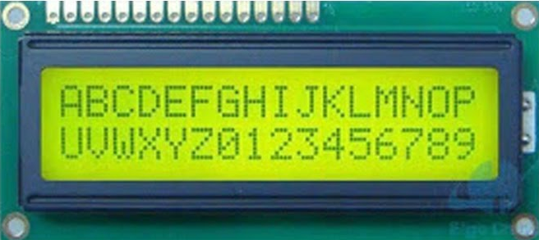



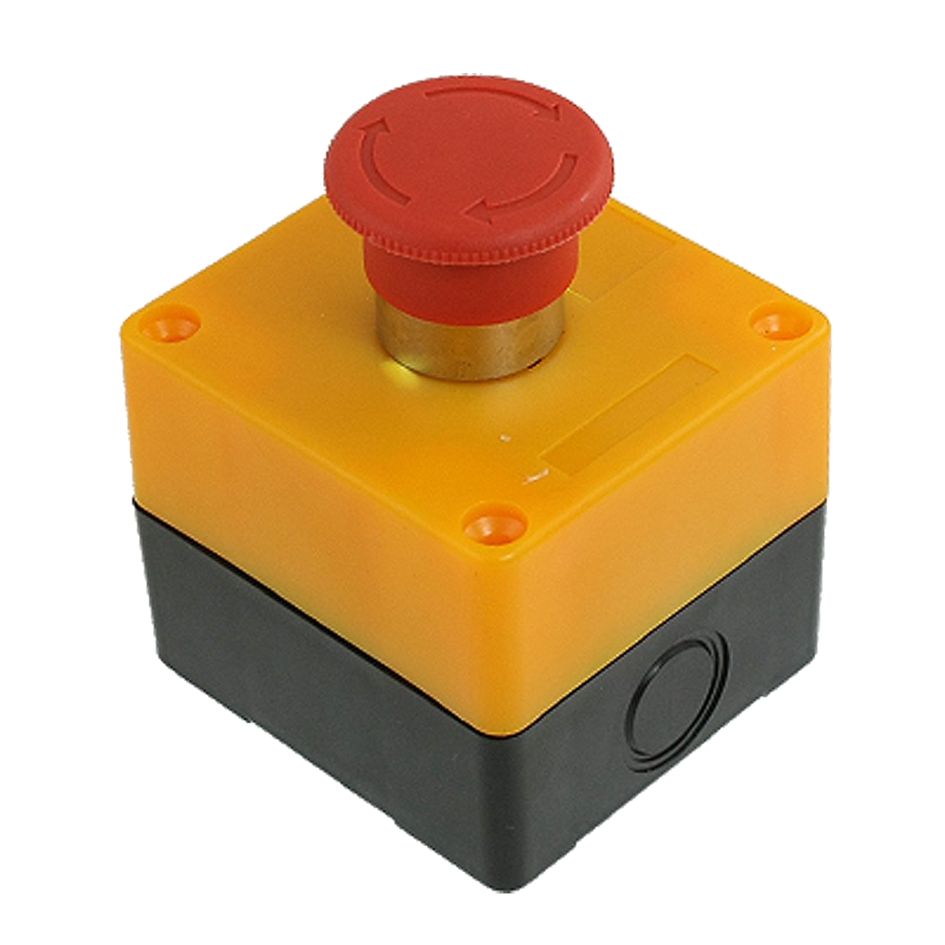
Components of the Solution
101010010101
Cycle
Windows
Toggle
Mute
Toggle
Camera
External
Wireless
PC software to
hardware
protocol
control Teams
Notes:
Approach is to:
Create some hardware that is sat on the desk to control teams:
Functions to:
Cycle windows to front
Toggle mute
Toggle camera
Then this is always available no matter what is happening on the desktop
Maybe with some display/audio to give feedback.
Device would communicate wirelessly with the computer running Teams
Using some protocol, I need to define
A software agent on the PC running Teams would listen to this protocol and control Team appropriately.

Slide 3
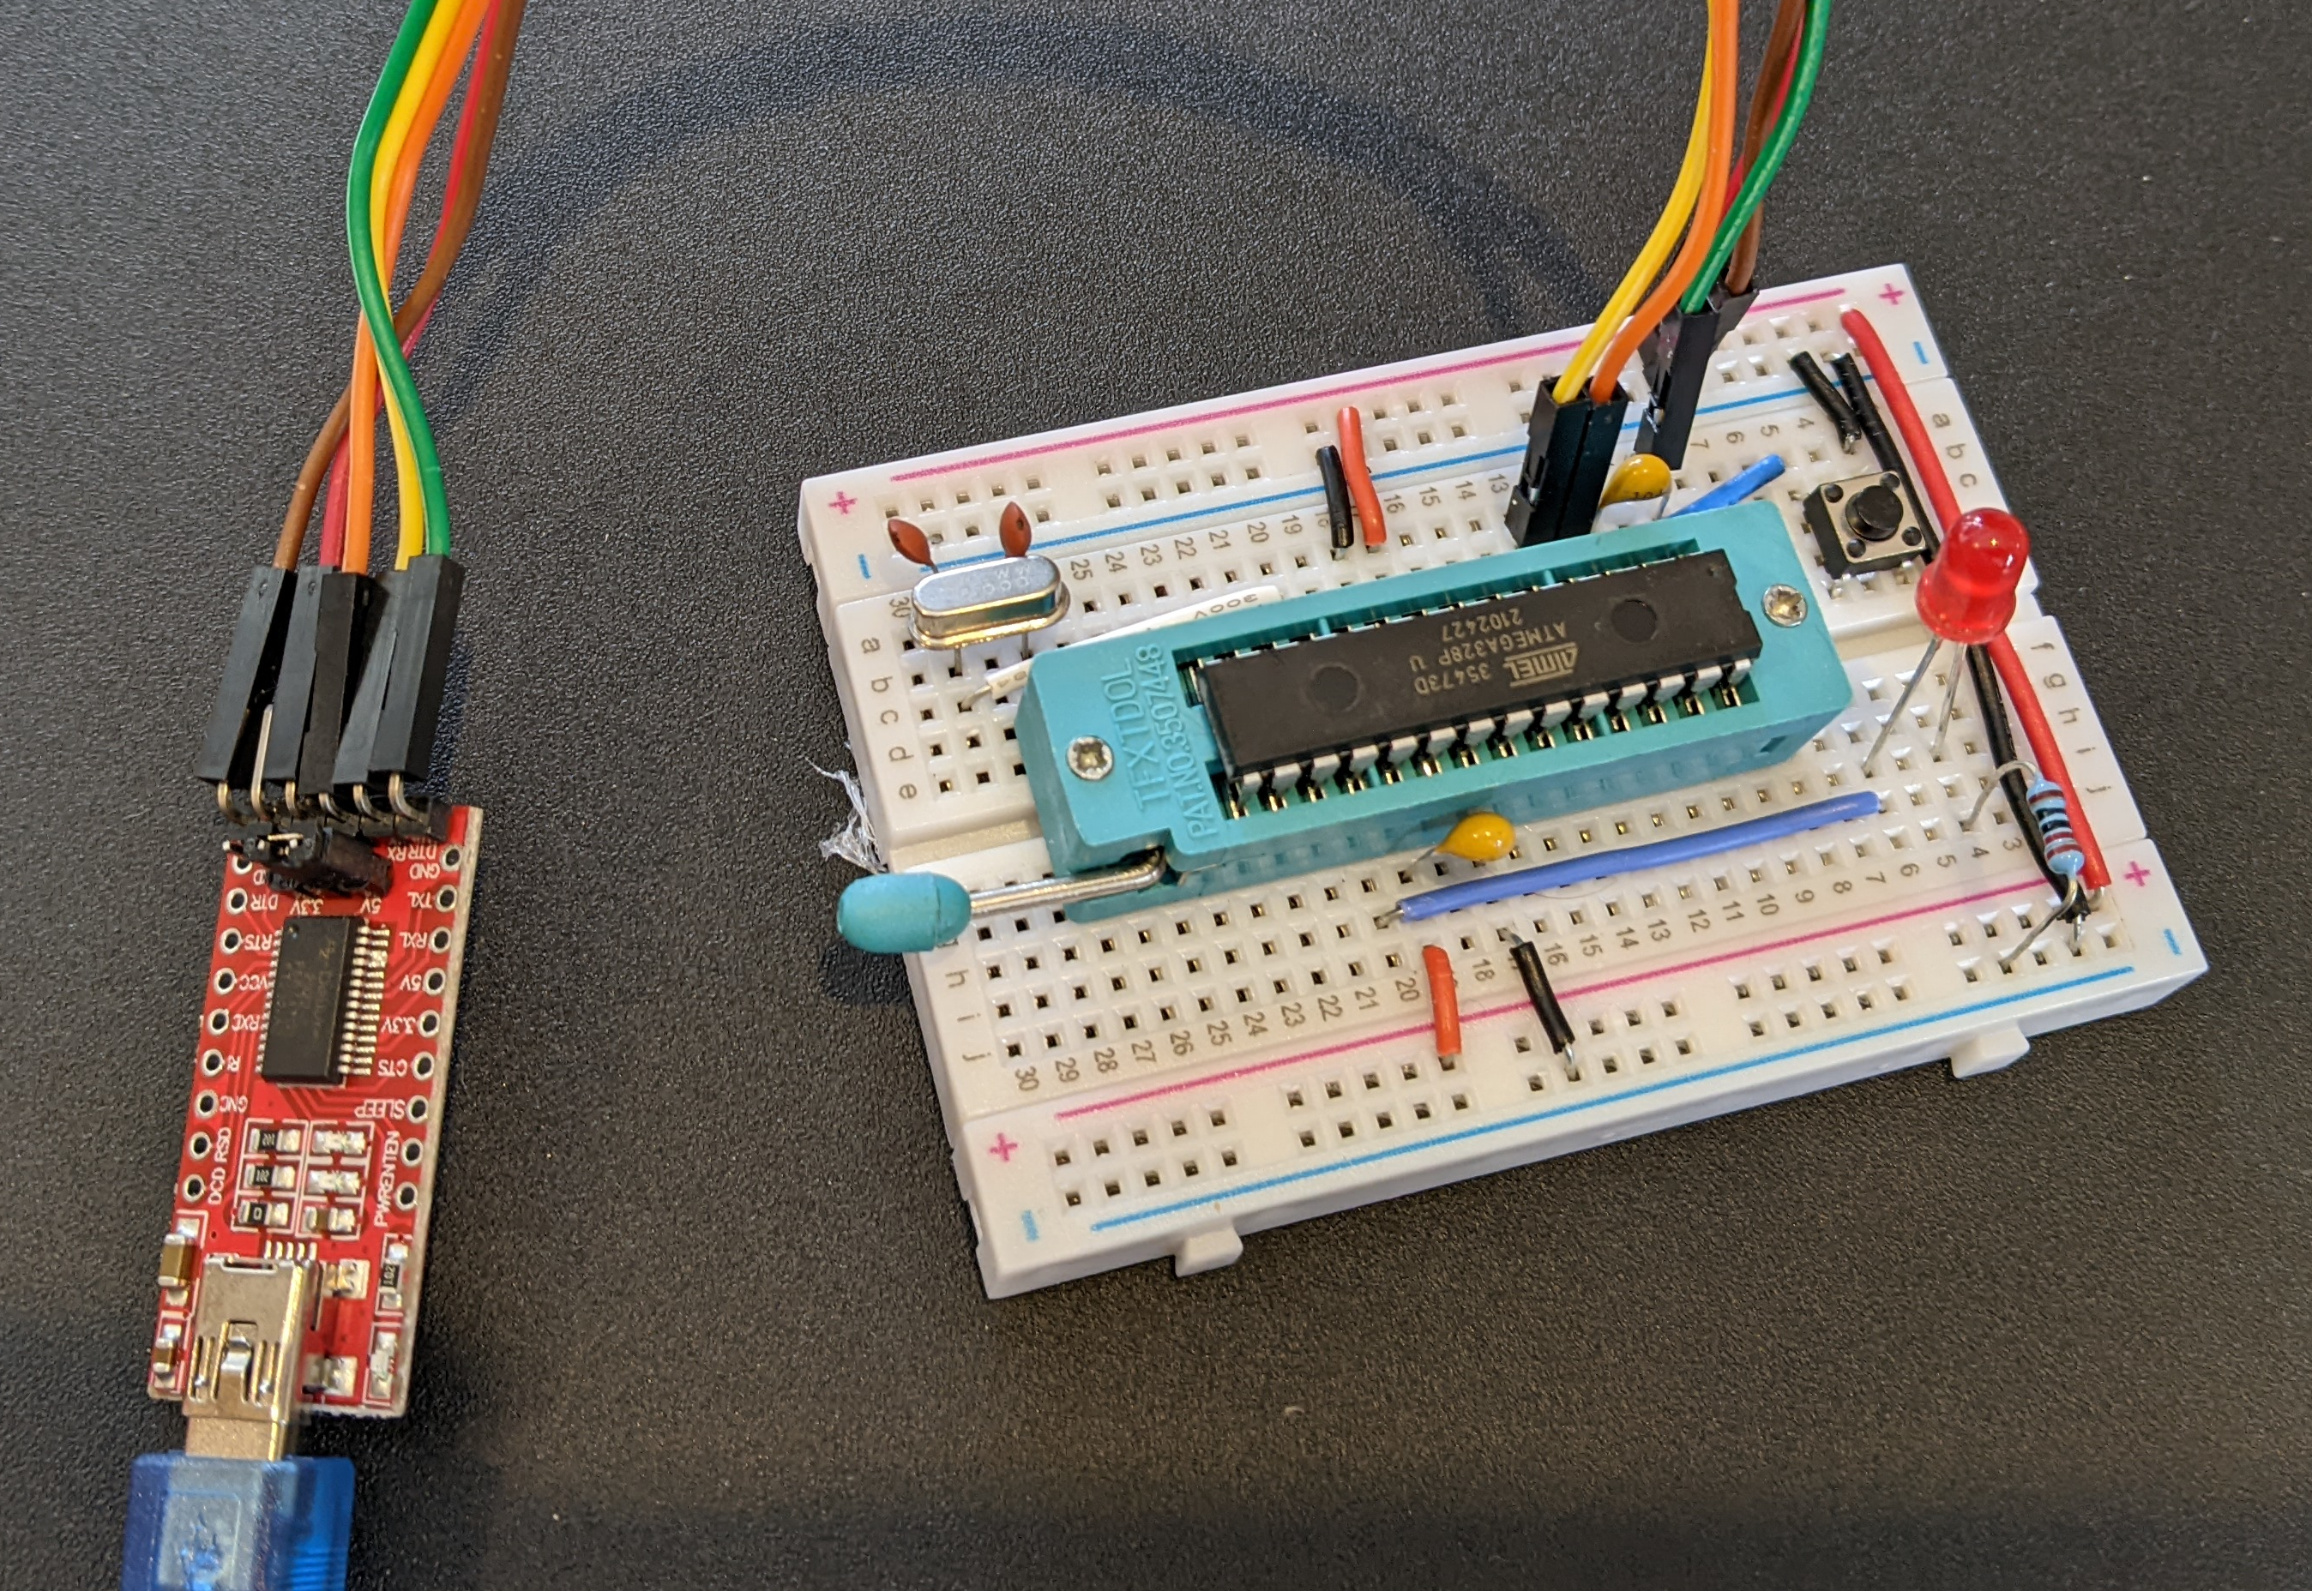
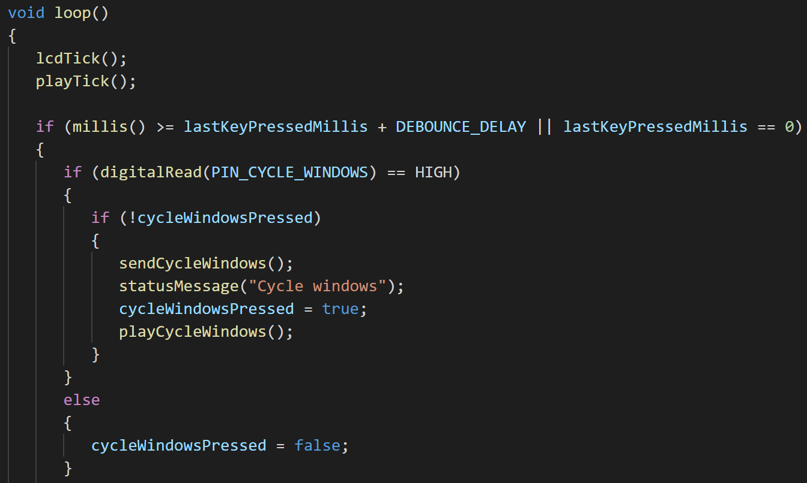
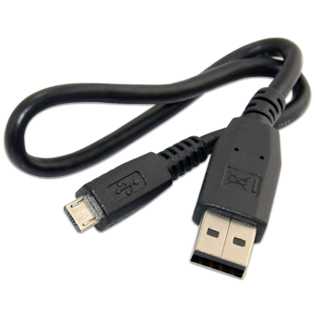
Hardware - Microcontroller
ATMega328
C++
Compile C/C++
ATMega328 Microcontroller (µC)
8bit @ 16MHz
32K Flash
2K RAM
14 Digital I/O pins
8 Analogue I/O pins
40 mA per pin
Initialize devices
Monitor I/O pins (for switches)
Marshall/send protocol
Drive display
Play tones
(De-)marshall protocol and dispatch
Upload Machine Code
Notes:
Hardware based around a Microcontroller
Start at the right!
The old familiar Arduino (nano)
Go through specs
Aside Microcontroller vs Microprocessor
Both capable of running a machine code programme
PI is full blown computer with a full operating system
Arduino just has a boot loader, and you are writing on the metal
PI can deliver maybe - 16mA per pin max not exceeding a total of 50mA
Arduino more like 40mA per pin max total 200mA max
So can drive a lot more directly from the Arduino
Arduino pushes C/C++ as Dev language as opposed to Python on the Pi
Arduino – simpler/less poweful and cheaper
Arduino – fewer interfaces – typically just USB
PI – typically WiFi, ethernet, several USB, HDMI
Process
Develop program on a PC in C/C++
Compile
Upload machine code to Microcontroller
Microcontroller will continue to run it while powered on (persistent through power cycles)
Explain the list of typical activities the code would do

Slide 4
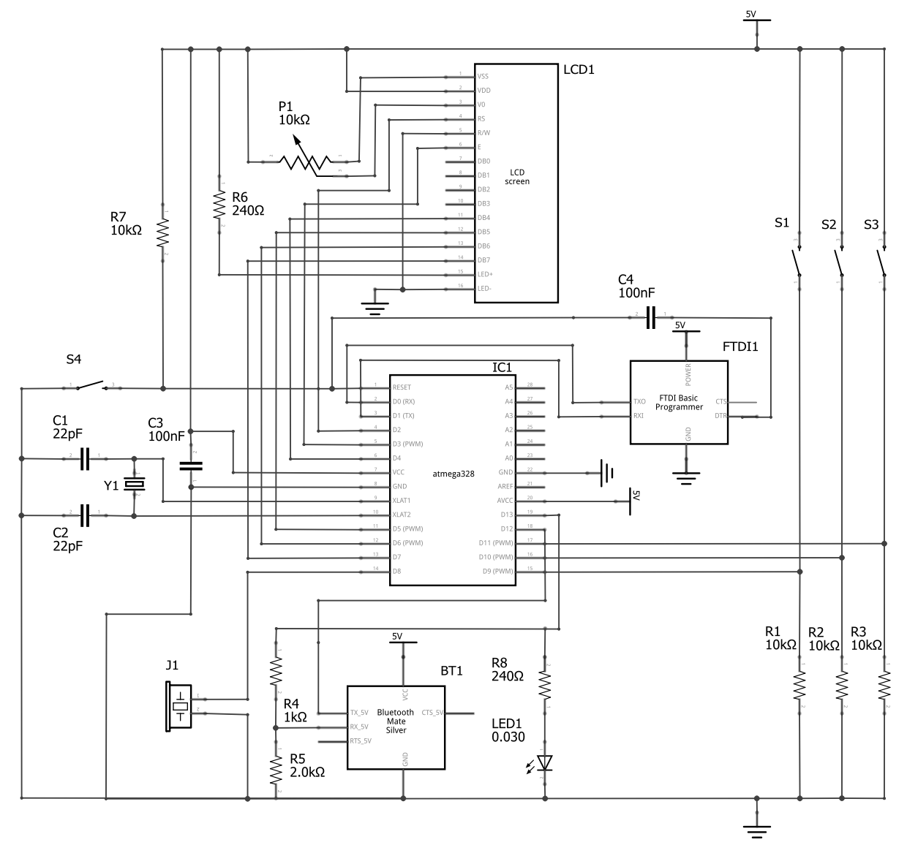
Hardware - Schematic
Triggering Actions
S1, S2, S3 – Tactile switches closing pulls the relevant pin high.
R1, R2, R3 – Pull down resistors
Reset Switch
R7 – Pull up resistor
S4 – Reset switch triggers reset by pulling RST pin low
Bluetooth Communications
BT1 – HC05 Serial to Bluetooth interface
R4, R5 – Voltage divider, ATMega uses 5V logic, BT card users 3.3V
JHD659
LCD
Screen
Visual Feedback
LCD1 - JHD659 LCD Screen
P1 - Adjusts Contrast
R6 - Current limiting resistor for LED backlight
Data lines etc. from µC
USB Comms & Uploading
FTDI1 - FT232RL serial to USB conversion
Connected to Rx/Tx lines on µC
DTR pulled low on new session – used to trigger bootloader
FTDI
FT232RL
Microcontroller Clock
C1, C2 and Y1 - Crystal circuit providing clock timing for the µC
ATMega328
µC
Activity LED
LED1 – Flashed by bootloader on activity
R8 – Current limiting resistor
Microcontroller
IC1 – ATMega328 µC
Runs uploaded machine code
Reacts to inputs pins
Sets output pins
HC05
Serial - BT
Audio Feedback
J1 – Piezo “speaker”
Notes:
This shows a schematic of the core of the circuit (sans details of the power supply)
Talk through each of the blocks
Start at microcontroller
Work anti-clockwise from top right
Power – USB, 5V or battery via Buck converter

Slide 5
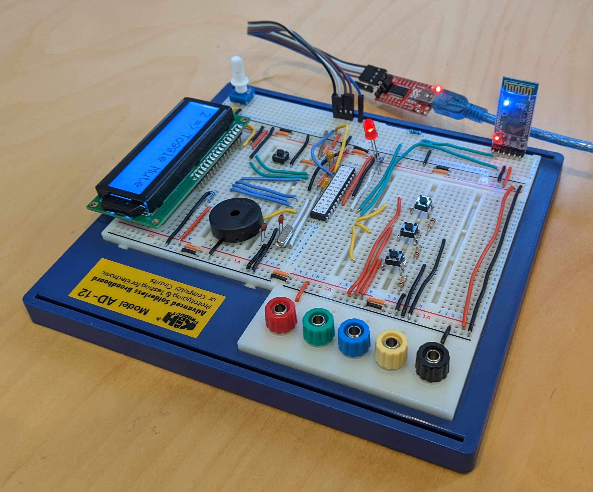
Hardware - Reality
S4, R7 Reset switch & pull up resistor
LED1 Activity LED
USB FT232RL
R4, R5 - Voltage divider
P1 LCD contrast
IC1 ATMega328
Bluetooth HC-05
LCD1 LCD Screen
S1, S2, S3 Action switches
J1 Piezo speaker
C1, C2 and Y1 Clock circuit
R1, R2, R3 Pull down resistors
Notes:
This is what the circuit looks like on a breadboard.
Say what a breadboard is
Point out some of the major components.

Slide 6
Protocol
Example - HELLO
Packet Structure
06 FF 48 45 4C 4C 4G
Offset | 0 | 1 | 2…n
Function | Length | OpCode | Payload
Length 6 (length byte not included)
Ascii - HELLO
Op code= Debug
Operations
On the Wire
OpCode | Name | In/Out | Payload | Description
0x01 | Cycle Windows | Out | - | Cycle Teams windows to the front.
0x02 | Toggle Mute | Out | - | Toggle microphone mute
0x03 | Toggle Video | Out | - | Toggle video camera
0x04 | Error | In | - | An error condition has occurred
0xFF | Debug | Out | String | Send a debug message
LSB first
0x06 = 0 0 0 0 0 1 1 0
0 1 1 0 0 0 0 0
5V
0V
Idle
Start bit
Data
Parity bit
Stop bit(s)
Notes:
Next piece of the puzzle is a protocol to communicate between the Microcontroller and the PC
Explain packet structure
Explain each message/opcode
One the wire
Typically lsb first
Idle = high – Great example of decisions living longer then we’d ever expect - Telegraph to show line and transmitter are not damaged!
Agreed
Baud Rate
Parity
Stop bits

Slide 7
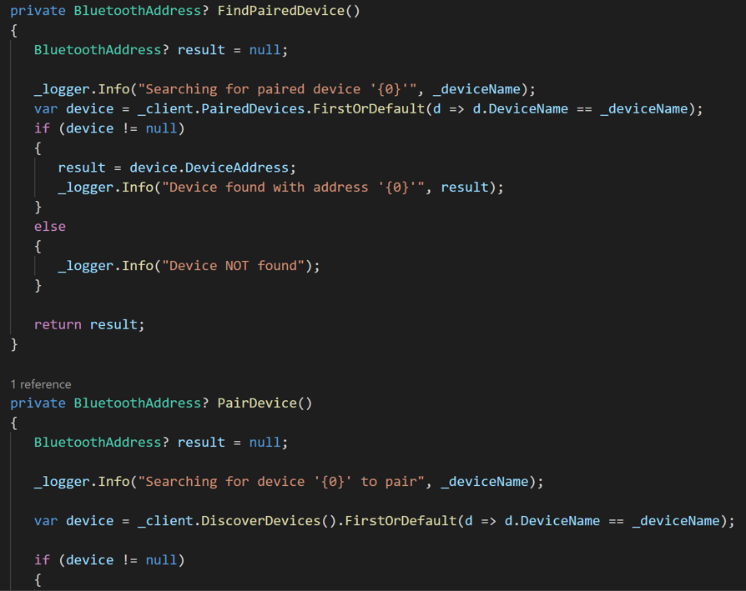
PC Software
C#
Pair and connect external device via BT
Listen for incoming protocol de-marshall protocol and dispatch
Interact with Teams to cycle windows/toggle mute/toggle camera
Send error conditions back to external device
Notes:
PC Software is other end of the protocol, acting on instructions from the Arduino and controlling Teams
Talk through the bullet points on the major actions of the software.

Slide 8
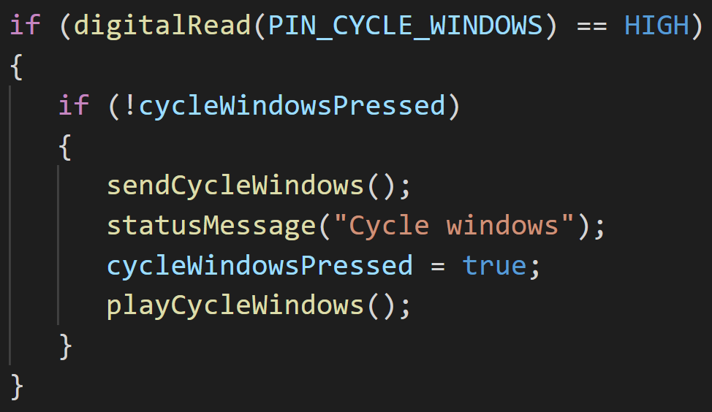

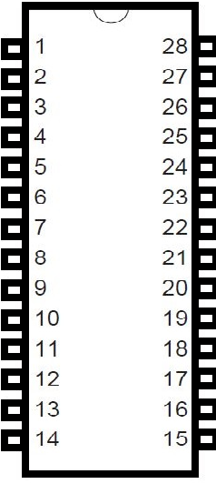
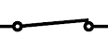
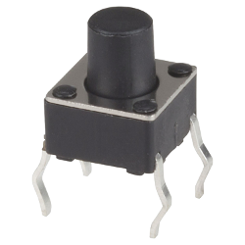


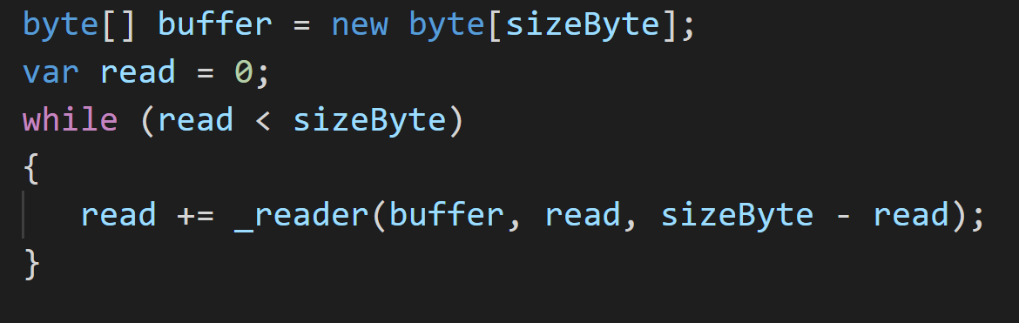
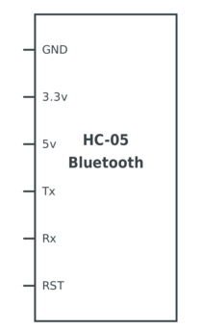


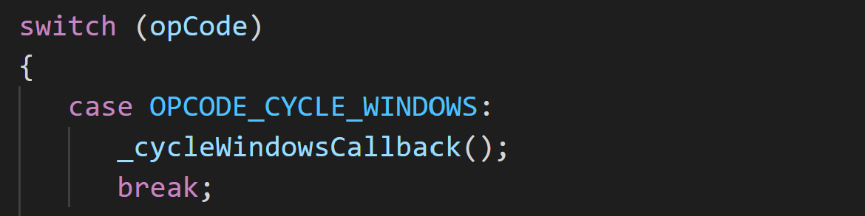
Tracing an Example
3
1
2
+5V
+5V
ATMega328
0V
0x01 0x01
7
6
5
4
4
HC-05
Notes:
Let’s follow through an example.
1. Cycle window button pressed
2. Pulls the relevant pin on the microcontroller high
3. The code detects this
Sends the appropriate data packet to the HC-05
We also send a message to the LCD and play a sound on the hardware
4. The HC-05 forwards this via BT to the PC
5. The software agent on the PC reads in the packet
Decodes the packet
Takes appropriate action against Teams
In this case cycling the windows

Slide 9
Demo

Slide 10
Bill of Materials
Core
USB
Bluetooth
Component | # | Total Cost
ATMega328 | 1 | £2.28
LCD Display | 1 | £3.99
Crystal | 1 | £0.12
Resistors | 6 | £0.06
Potentiometer | 1 | £0.07
Capacitors | 3 | £0.12
Switches | 4 | £0.12
Piezo Buzzer | 1 | £0.50
LED | 1 | £0.03
Component | # | Total Cost
FTDI FT232RL | 1 | £3.30
Capacitor | 1 | £0.04
Component | # | Total Cost
HC-05 | 1 | £4.80
Resistors | 2 | £0.02
£3.34
£4.82
Battery Power
Component | # | Total Cost
Buck Converter | 1 | £2.33
£7.29
£2.33
Notes:
This is how much it all costs
You might be able to get things a little cheaper via Ebay if you are prepared to wait!
Explain the 3 different tables.

Slide 11
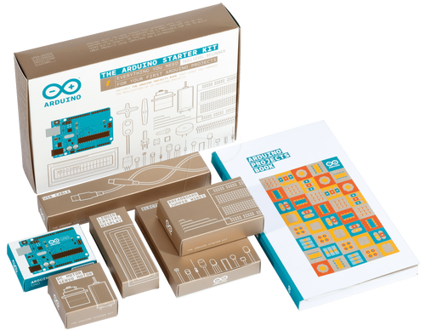
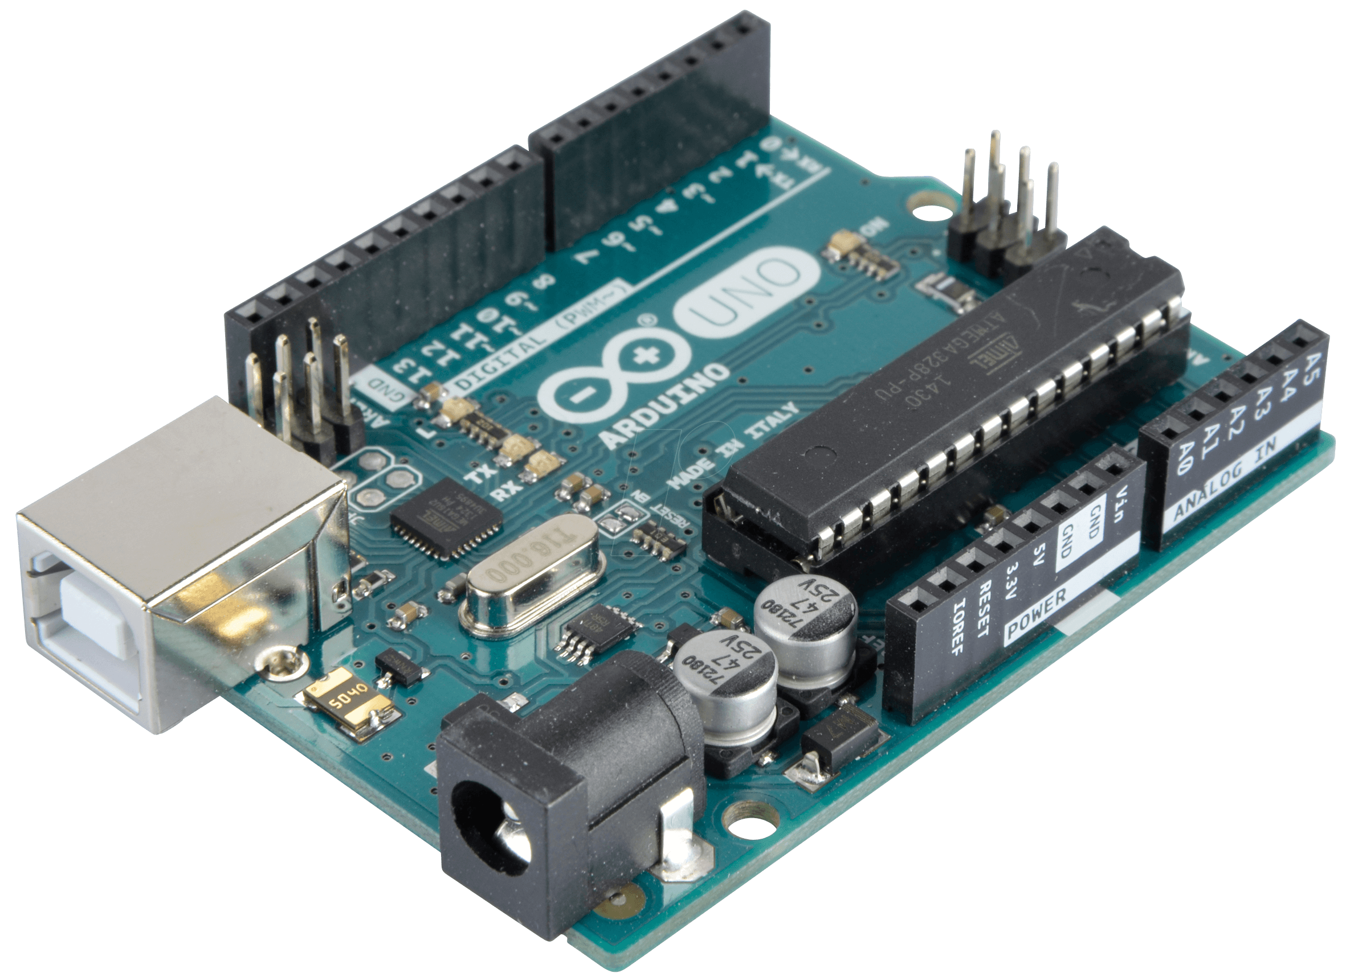
Try Yourself?
The
Arduino
Starter
Kit
Notes:
If I have whetted your appetite for playing with hardware
You might have heard of an Arduino?
The ATMega328 is at the heart of the Arduino
Plus it offers all the supporting circuitry needed to get it going and more.
I can recommend with the Arduino starter kit
It requires very little knowledge of electronics
Real projects talked through in the projects book
Everything you need is in the kit
Components of these can be built into more ambitious ideas
Get’s you into building
In fact, you could build a USB (not BT) version of the above with it.
It is great fun!

